Slide 1
Pushing Positive Mental Health In Your Club Unite Conference

Slide 3
Aim:
Demonstrate the importance of speaking about mental health
Objectives:
Understand on going support is available
Identify how all members can support each other

Slide 4
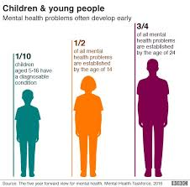
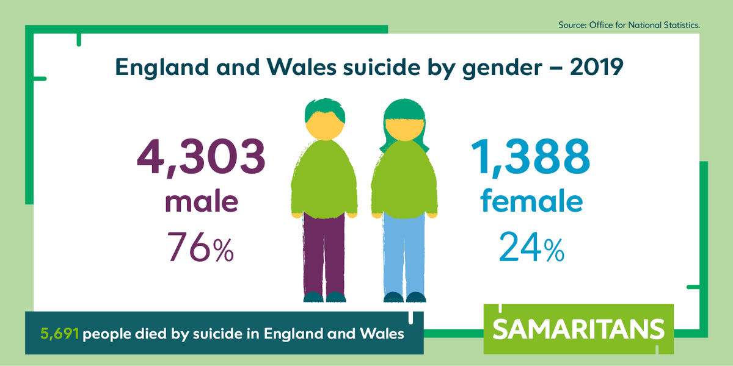

Slide 5
What can we do to support?
Understanding your members is the main focus. Your club will have a lot of different meanings to different members
Social club, elite club, fitness goals and positive wellbeing
This is important as different people will have different ways they would want support from the club.

Slide 6
Suggestions for support, to get everyone back thinking about having sport back, start some competitions around “Favourite photo” this will help create some positivity and also reduce anxiety for some members.
Share podcasts around athletes speaking about different struggles in and out of sport. This helps athletes understand they are not the only ones going through tough times
Set up a coffee club before or after training for some downtime and just give people a safe space to check in
Put posters up around the club that promote support that is always available

Slide 7
How could you help your members?
Be a Positive Support - Look Out For Others
Know the signs
Talk to them
Talk to friends/family/Coaches

Slide 8
Starting the Conversation
Pick a safe place to talk. Quiet room, go and get a coffee or outdoors
Let people know its ok to be not ok …
Listen
Encourage them to speak to others and get help

Slide 9
There is always support available ..
Mental health helpline wales: 0800132737 or Text- Help to 81066
Hafal (Welsh charity): 01792 816 600/832 400 / www.Hafal.org.uk
YoungMinds: 08088025544 / Text YM to 85258
Samaritans: 116 123
NHS direct: Call 111 / www.nhsdirect.wales.nhs.uk
Emergency services: 999

